Slide 1
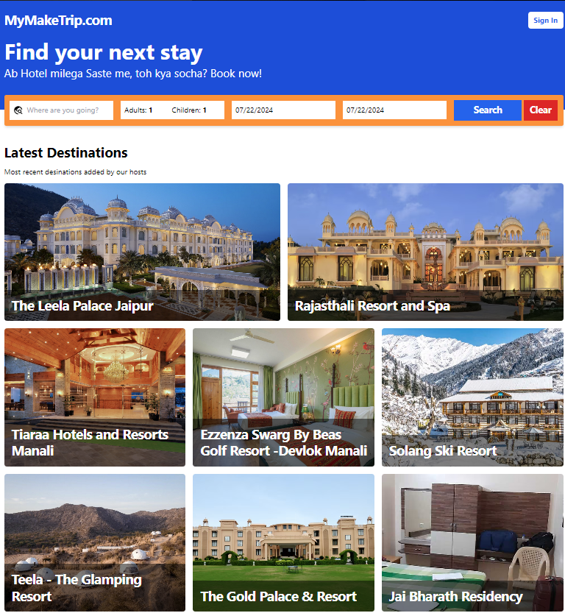
Hotel Booking System

Slide 2
Members
Arijit Deb
Abir Lal Mukherjee
Aman Shaw
Jennifer Christiana Piper
Keyon Daniel Alley

Slide 3
Introduction
For our project of choice, we decided to proceed with a Hotel Booking System, thereby providing the user(s) with a fast and easy to use application to select their economical choice of stay whether it be a dream vacation commodity or a simple cozy room to stay the day/night.

Slide 4
Additional Resources used
To achieve our task of creating such a website, numerous options were present to do so, in the end we decided on the following to assist us:
MongoDb – to collect, store and access user information with close to no delay
Stripe – to act a payment medium between user and developer
Render – to deploy our final product so-as-to be accessible via the link https://makeatripv1-5.onrender.com/

Slide 5
Features
The website provides the user(s) with the following features:
My Hotels/Add Hotel: allowing the user(s) to view their hotel entries as well as providing them with the option to add additional choices for the Admin to view
My Bookings: allowing the user(s) to view previously booked hotels
Booking: allowing the user to view and book a hotel taking into account numerous requirements such as date, time, head count etc.
Search: allowing the user(s) to view the hotel options according to a given criteria such as location, rating, price etc.

Slide 6

Our Website

Slide 7
Homepage
On entering the website, the user will be greeted by our homepage providing them with a snippet of our service

Slide 8
Sign in inactive
By default, the website register the user as inactive for security reasons.
Hence when entering the website, the user is required to sign in with their registered account and password.

Slide 9
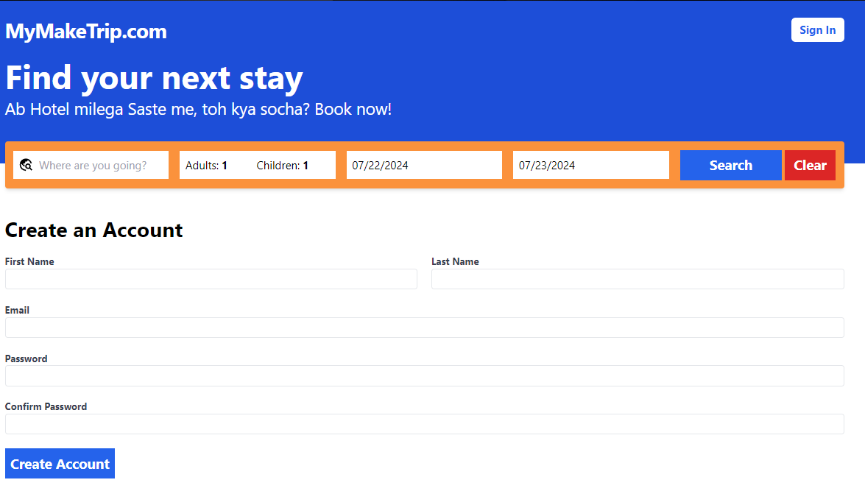
Register
This feature allows new users to create an account on the website with information that will be safely stored in our backend via our database of choice as well as providing them with any features that may have been locked out when they had no existing account.

Slide 10

Sign in active
Successfully signing into the website will provide the user with additional features.

Slide 11
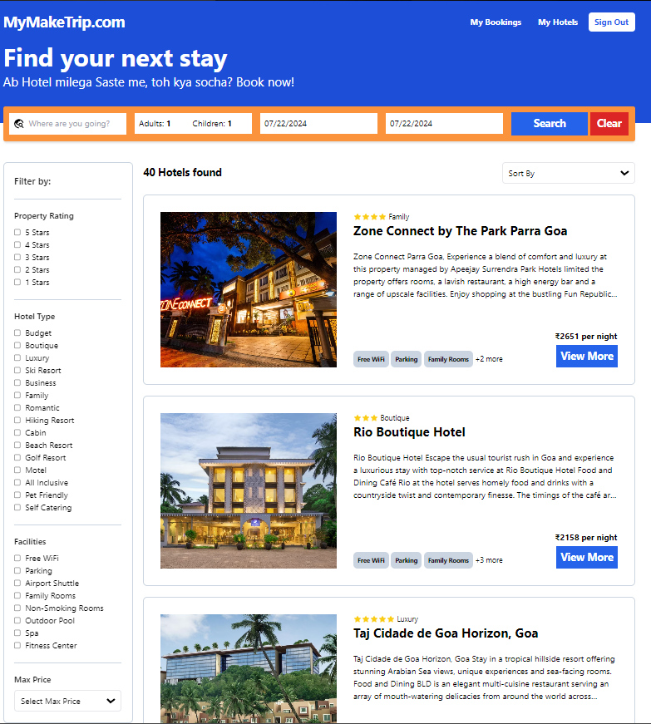
Search Feature
This feature is active to all users, signed in or not.
This feature allows the user(s) to view a choice within any criteria they require as given via the filter types

Slide 12
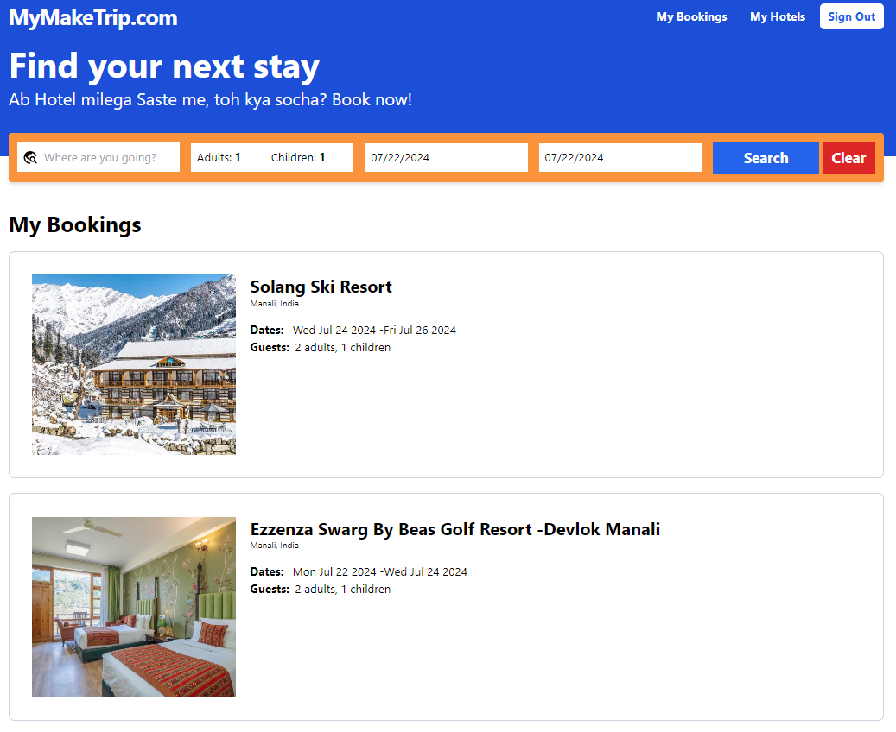
My bookings feature
This feature allows the user to view any bookings they may have made in the past thereby creating either a reference or if they wish, a faster option to another booking

Slide 13
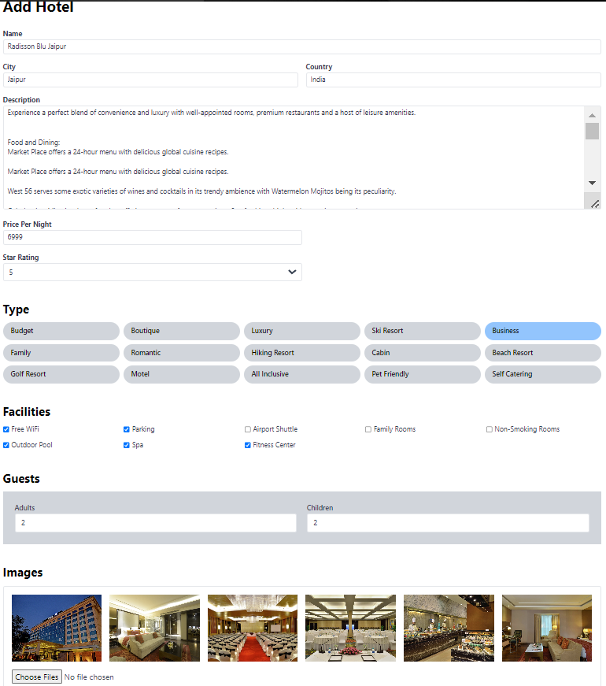
My hotels feature
This feature provides the user with a list of any selections that have been approved by the admin as an option for the website to host

Slide 14
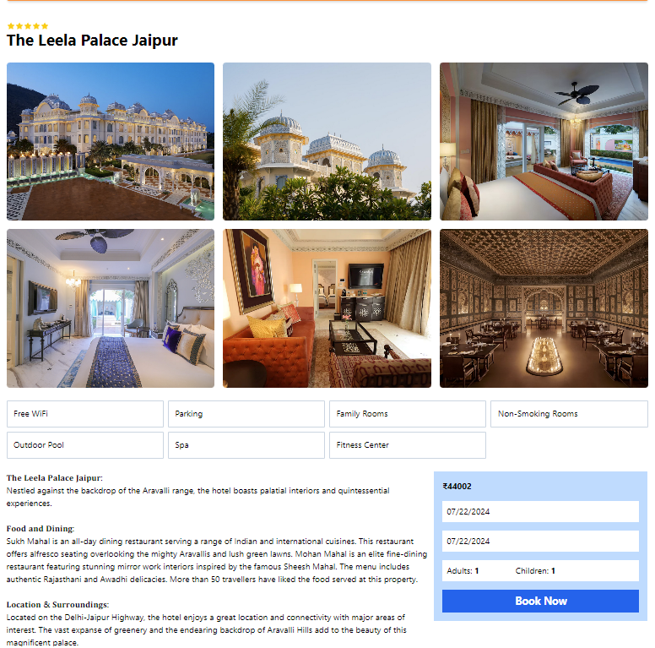
Booking section
This feature pops up when the user is ready to finalize their hotel selection of choice and are ready to proceed to the payment thereby solidifying their booking

Slide 15
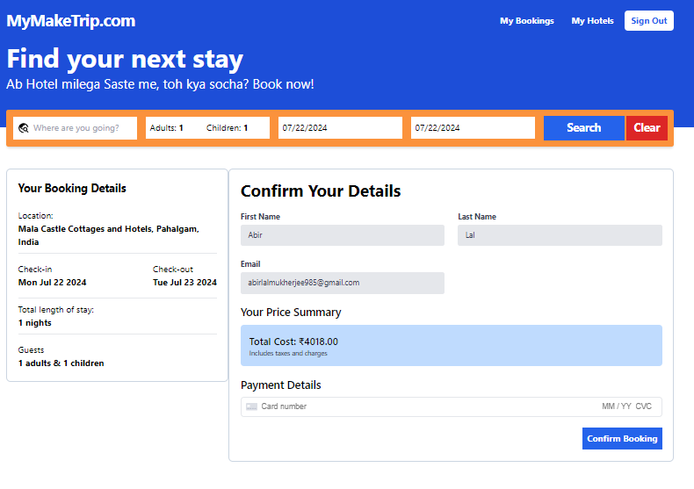
Booking confirmation section
This section pops up when the users’ booking has been successfully completed

Slide 16
Conclusion
In conclusion, the development of the hotel booking site has successfully addressed the need for a user-friendly and efficient platform for travelers. By incorporating dynamic search features and a payment gateway, we have created a solution that enhances the booking experience. While this project represents a significant milestone, we believe there is ample opportunity for future enhancements, such as location-based service and dynamic pricing according to demand. We are confident that this website has the potential to revolutionize the hotel booking industry.

